Slide 1
E-PROJECT
VINEGAR FOOD RESTURENT
Design by
FAHAD TARIQ
UMAR
Student1157257
STUDENT1155635

Slide 2
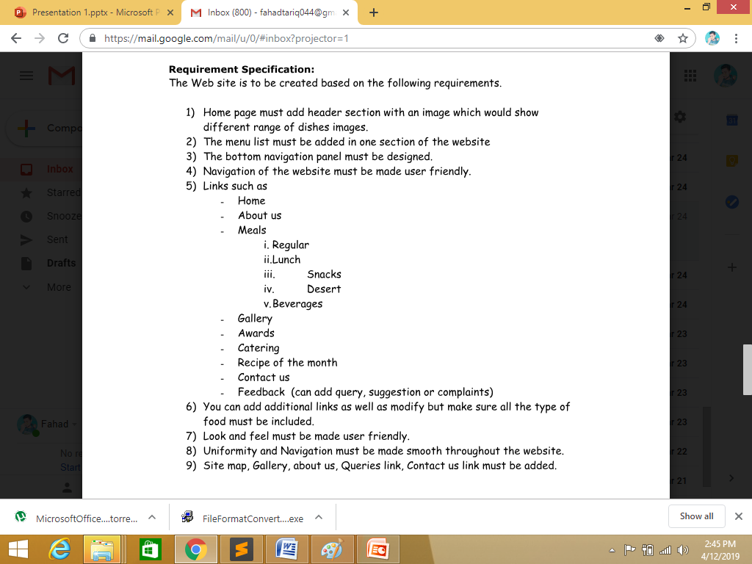
Requirment

Slide 3
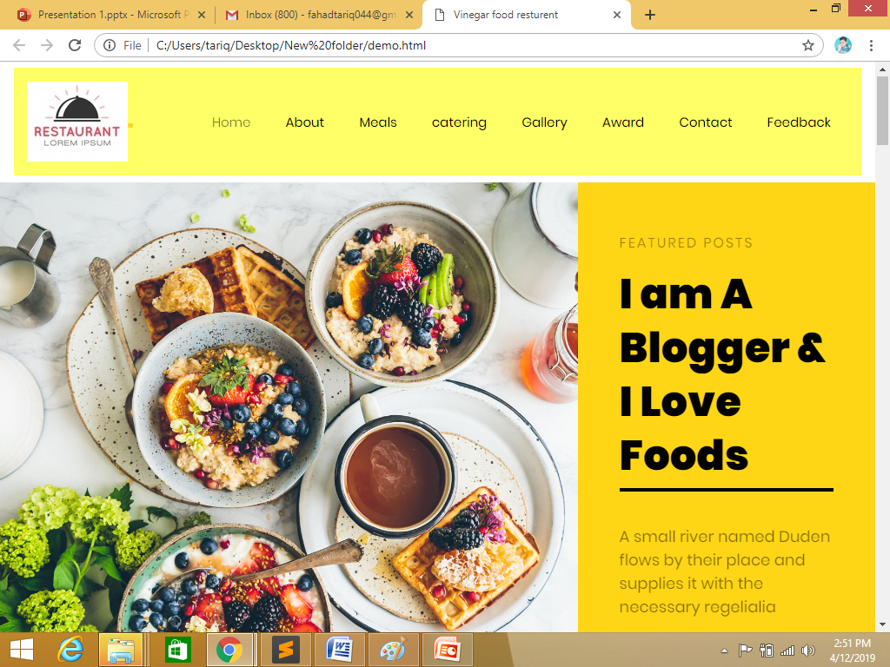
Home page
Requirment 1 Home page must add header section with an image which would show
different range of dishes images.

Slide 4
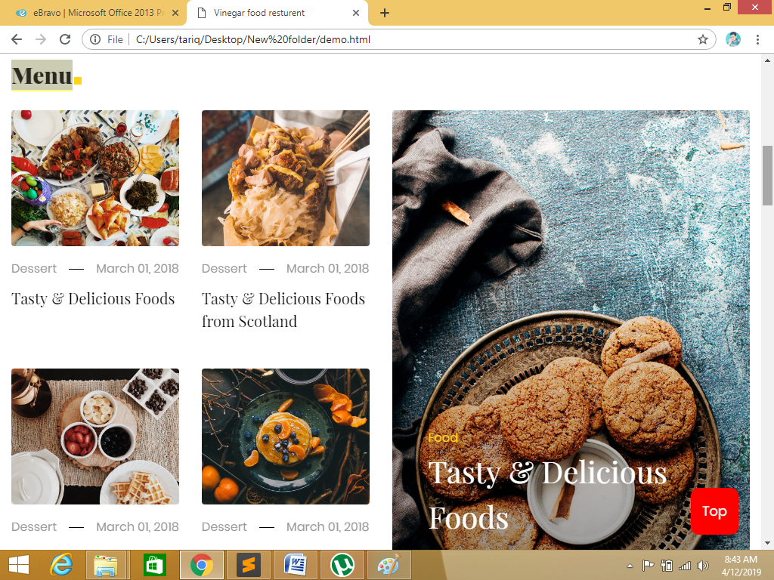
HOME PAGE
Requirment2)
The menu list must be added in one section of the website

Slide 5
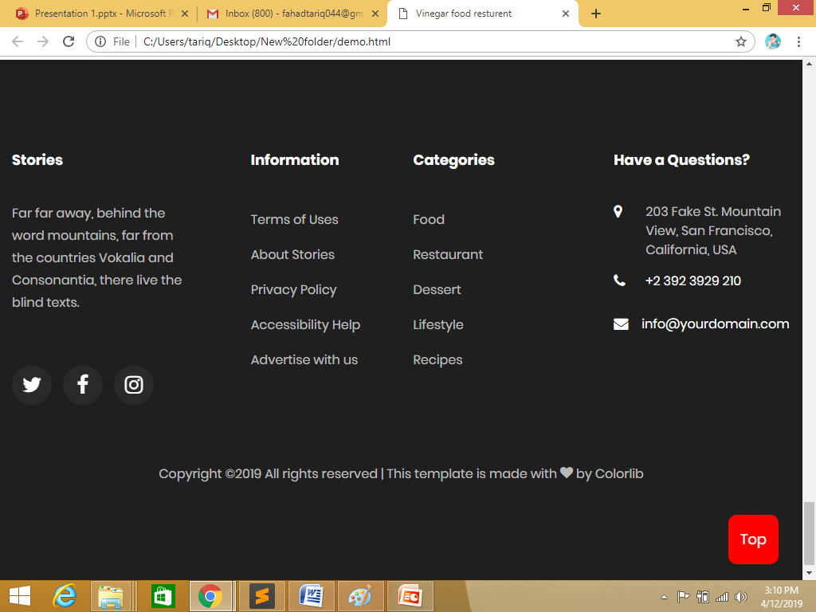
Footer
Requirment3)
The bottom navigation panel must be designed.

Slide 6
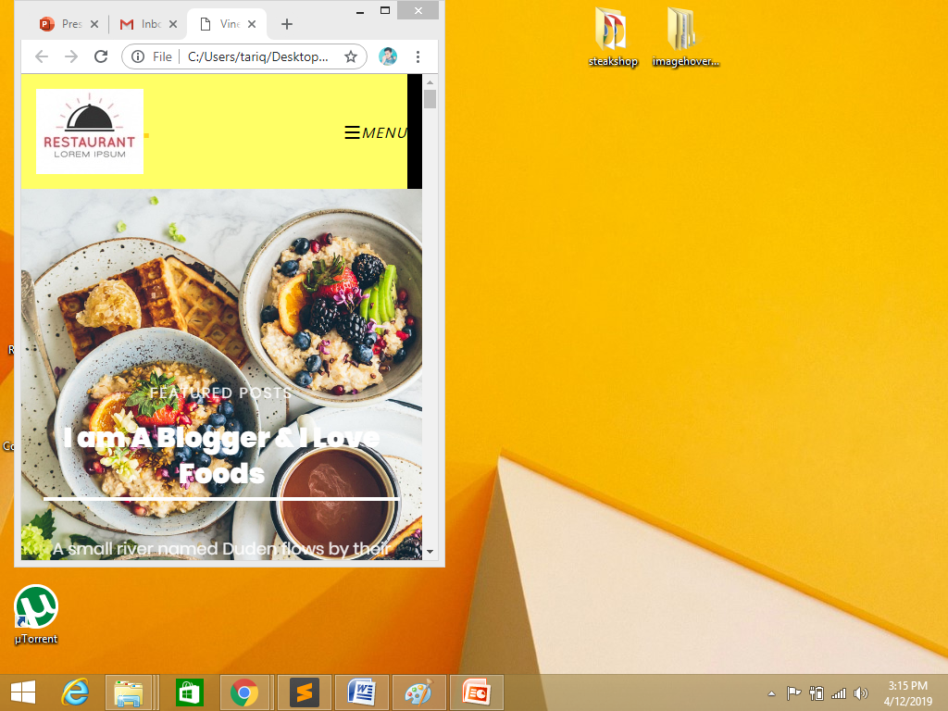
Requirments
Requirment4)
Navigation of the website must be made user friendly.

Slide 7
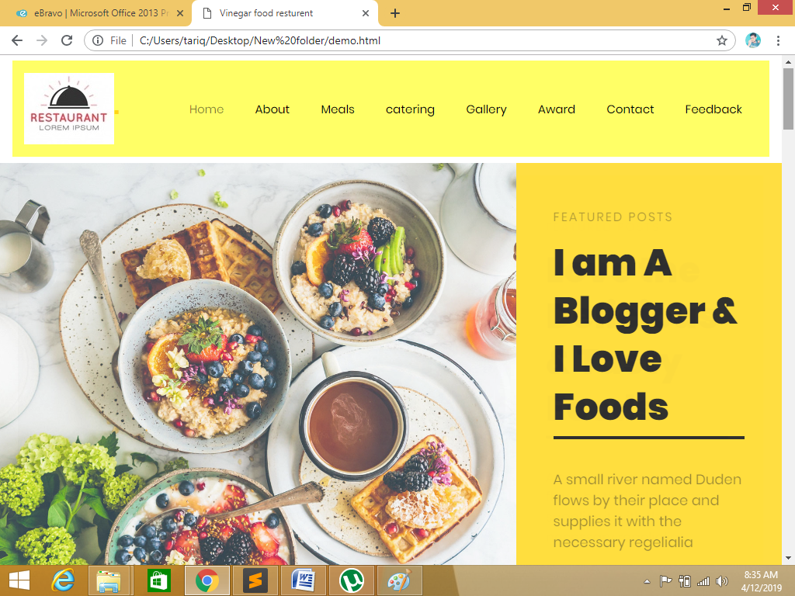
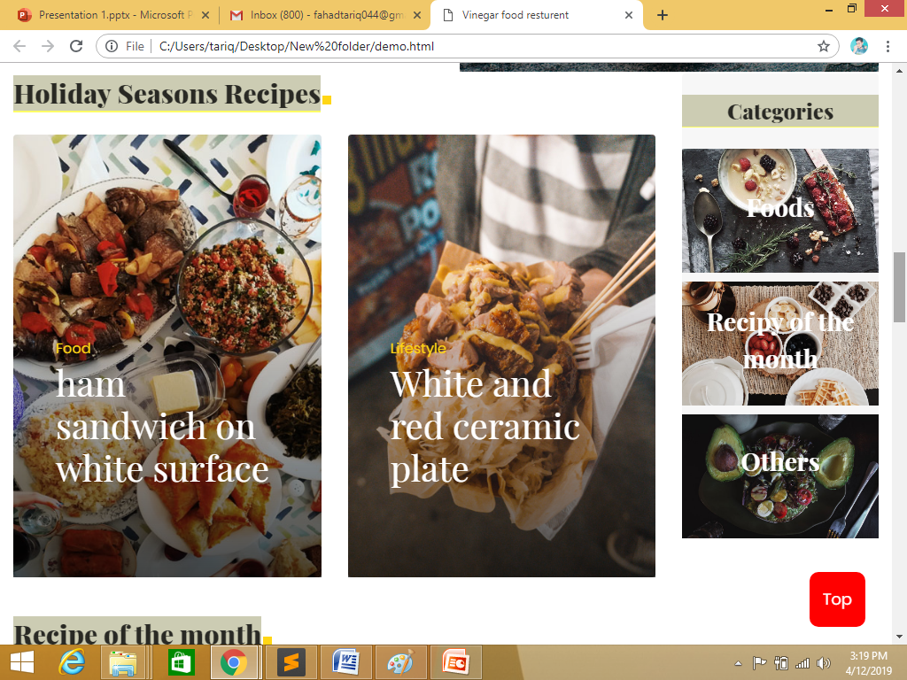
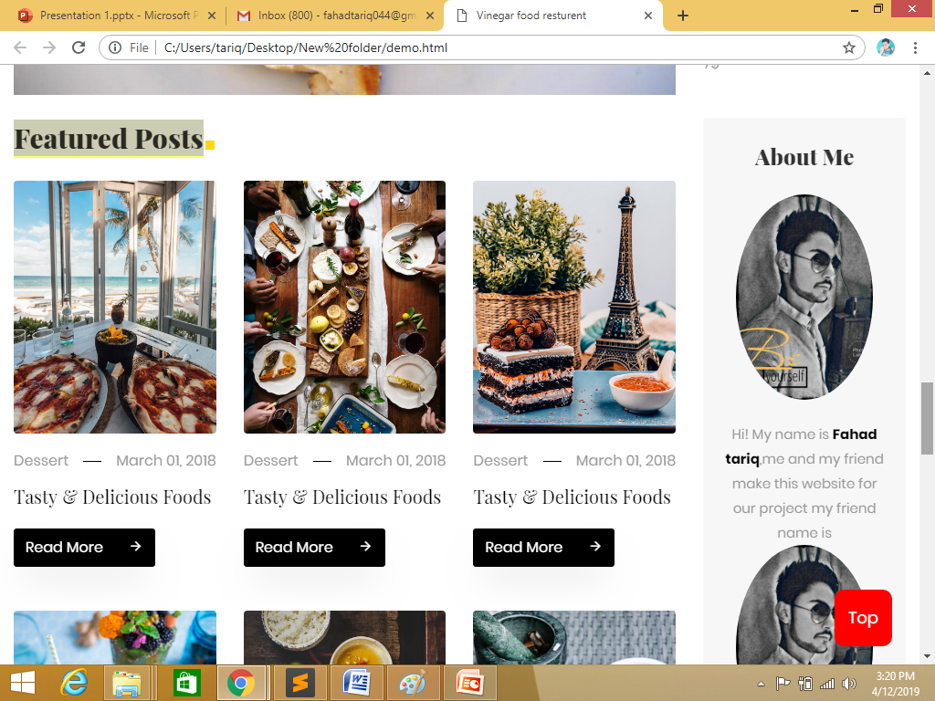
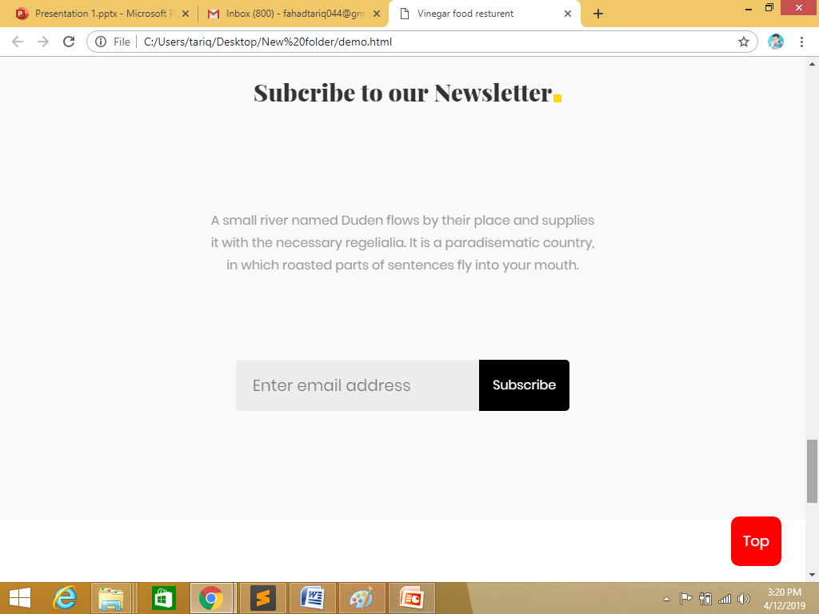
HOME

Slide 8
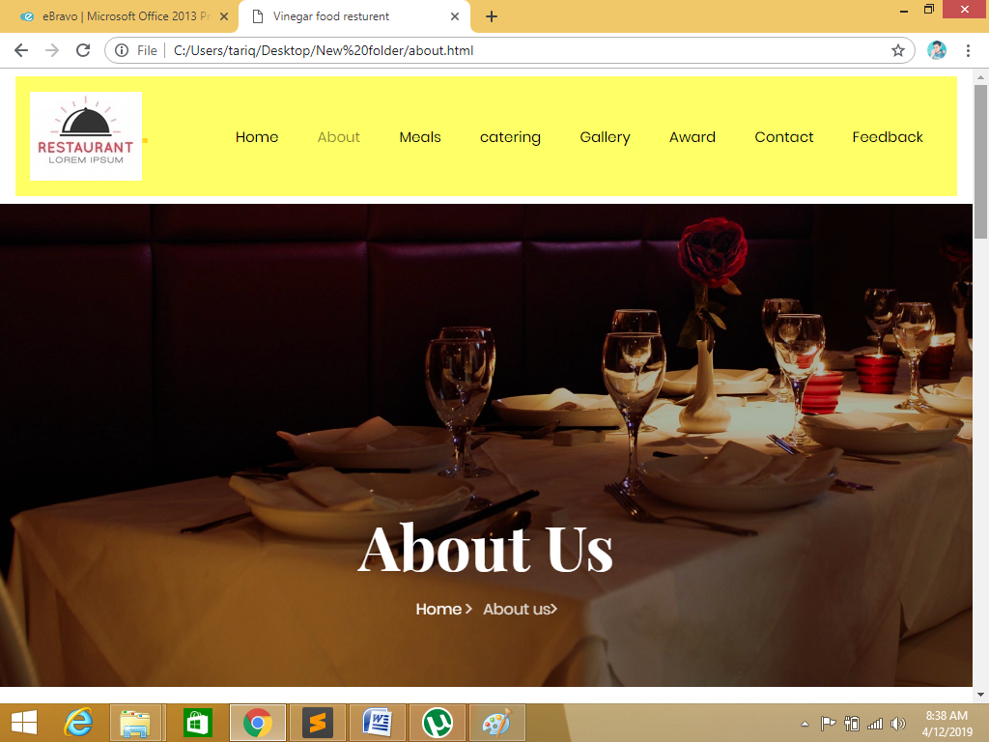
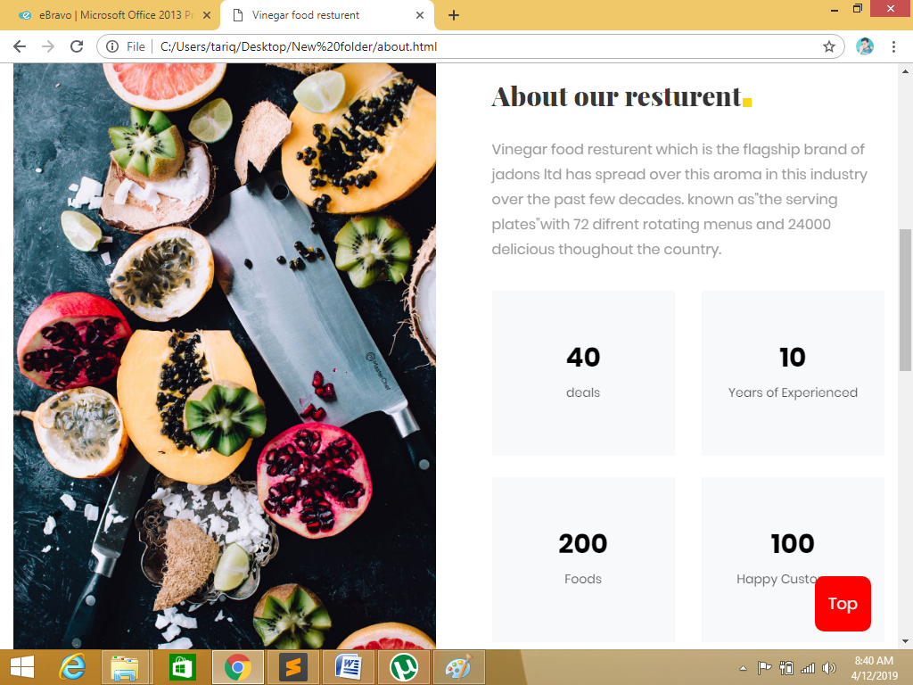
About

Slide 9
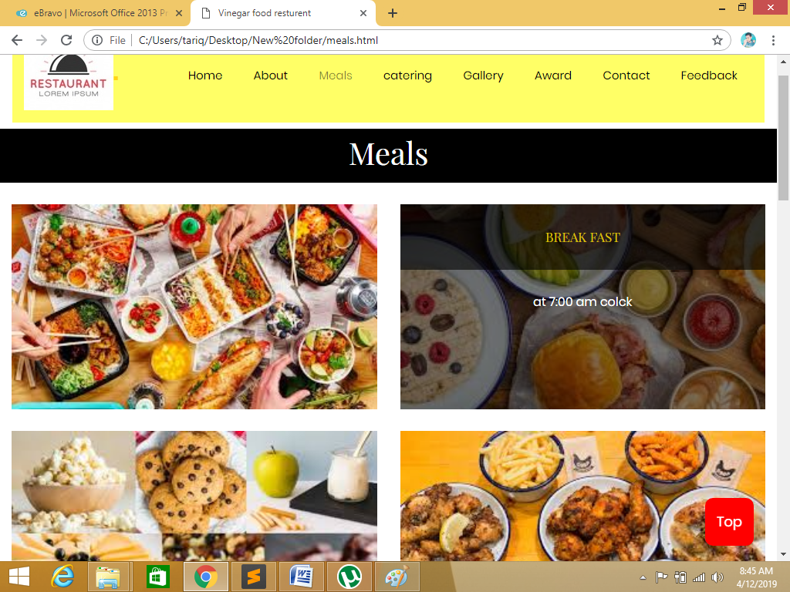
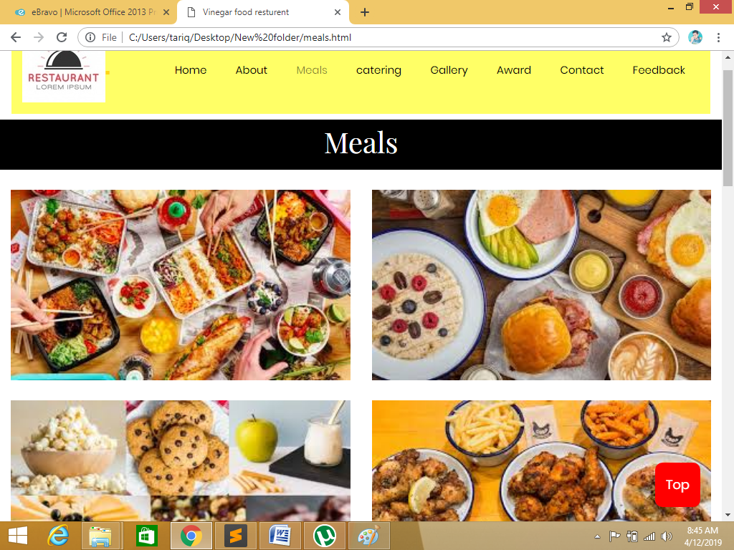
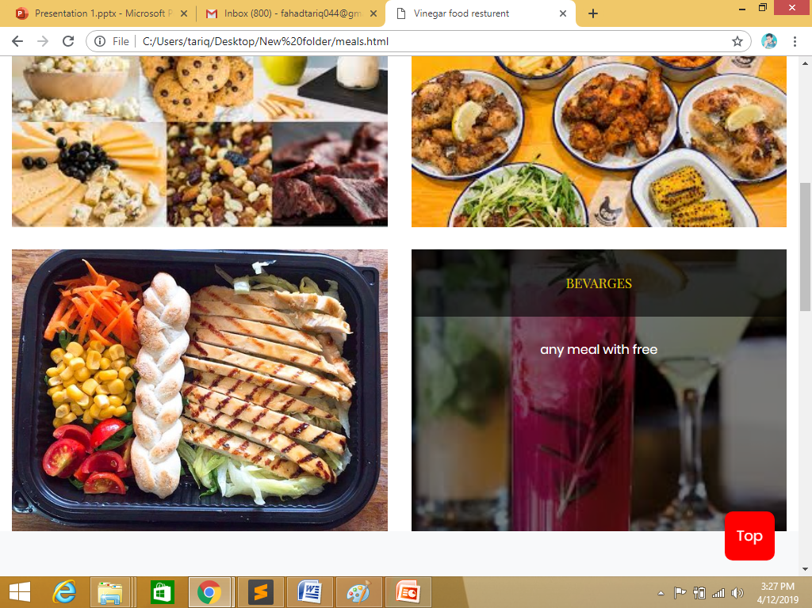
Meals

Slide 10
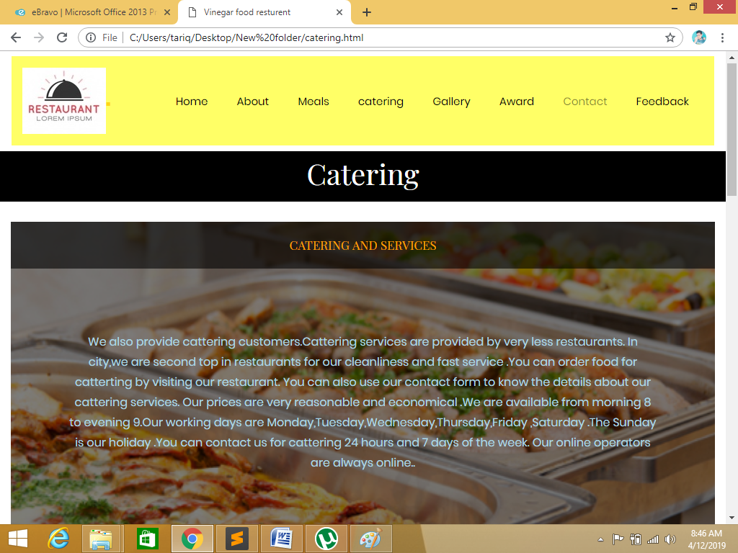
Catering

Slide 11
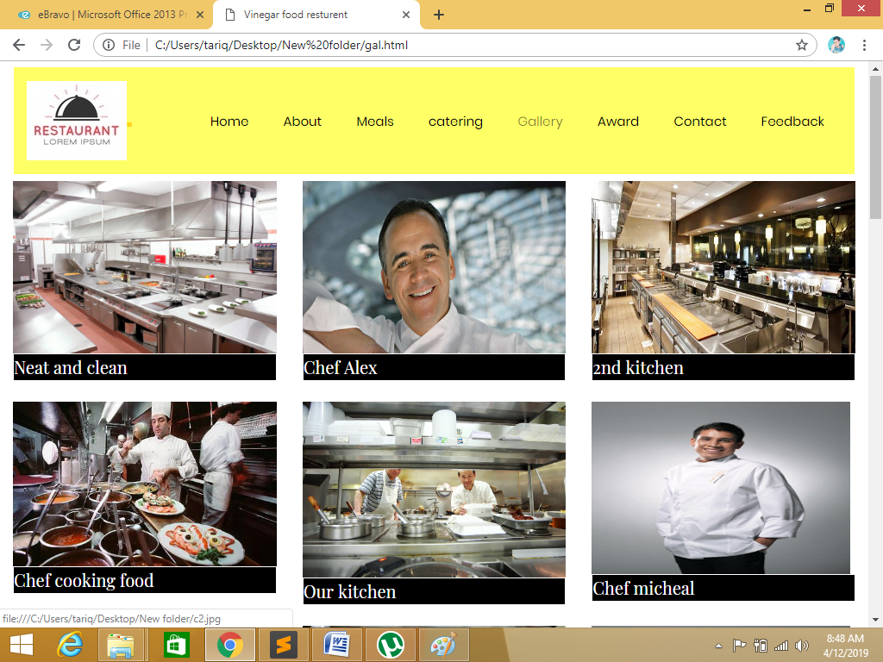
Gallery

Slide 12
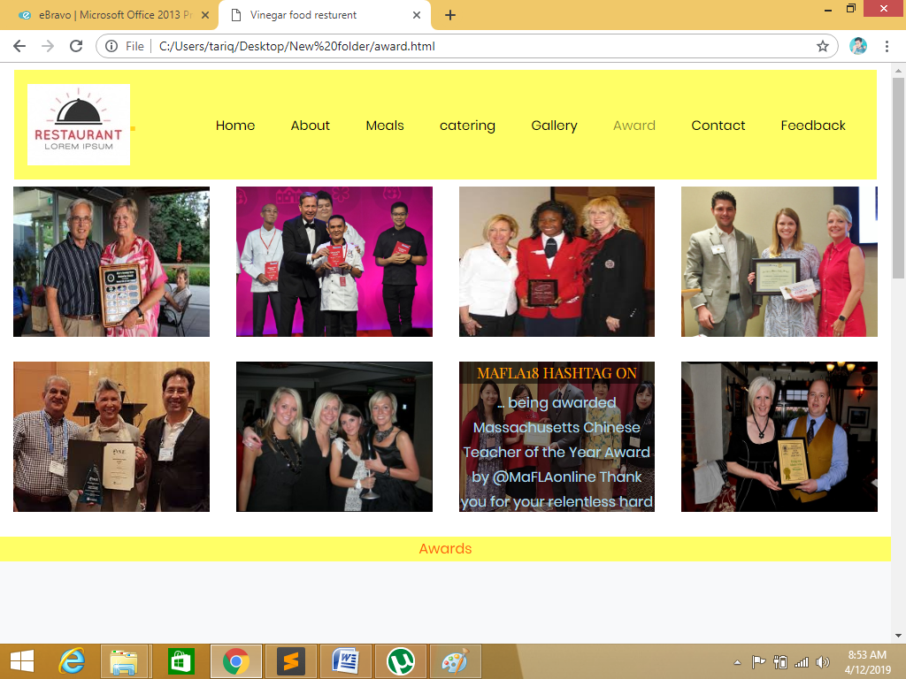
Award

Slide 13
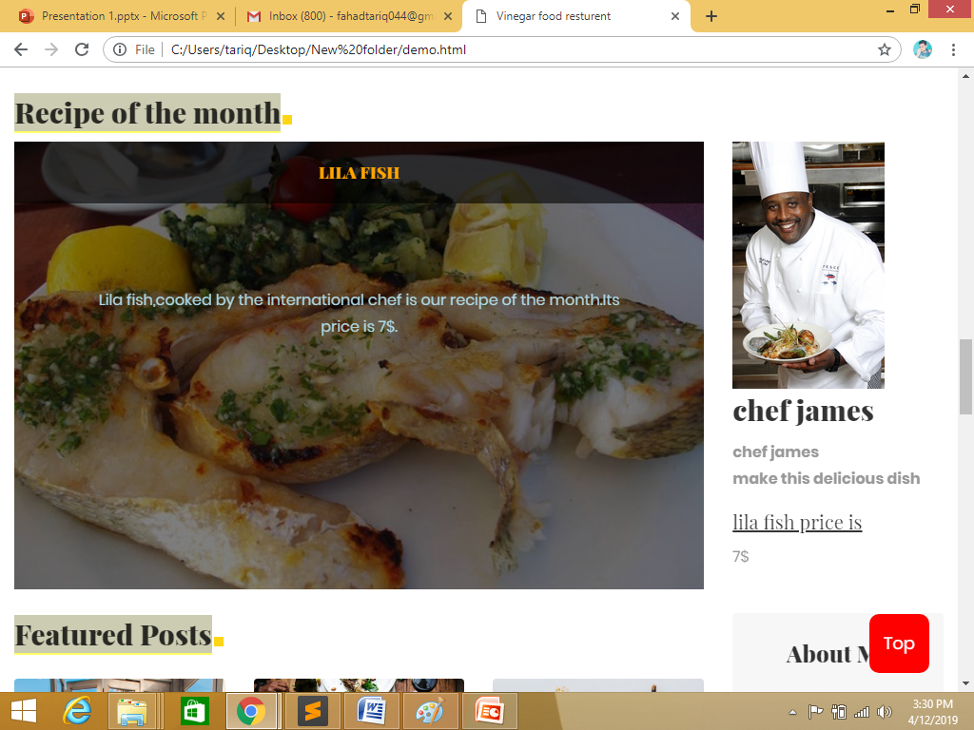
Recepy of the month

Slide 14
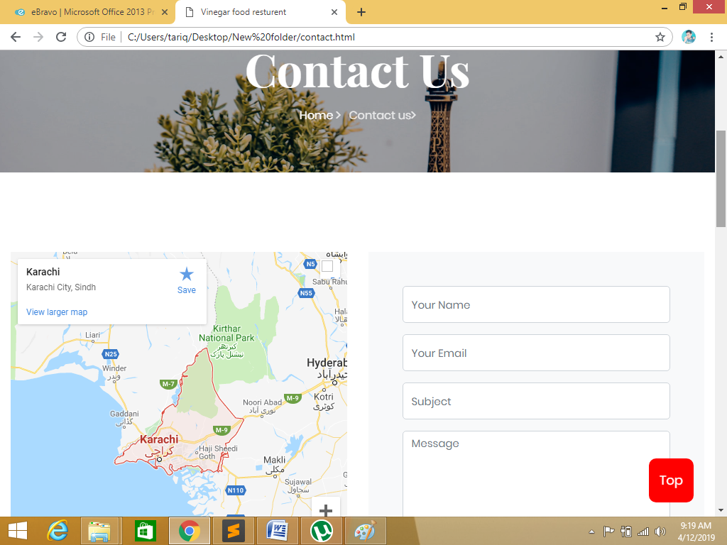
Contact us

Slide 15
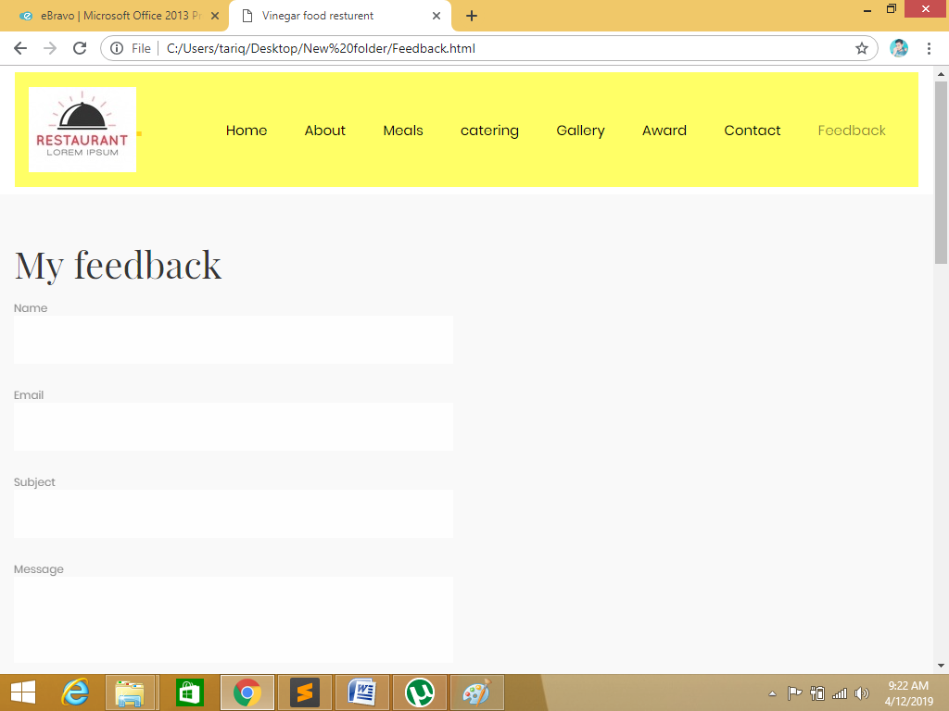
Feedback

Slide 16
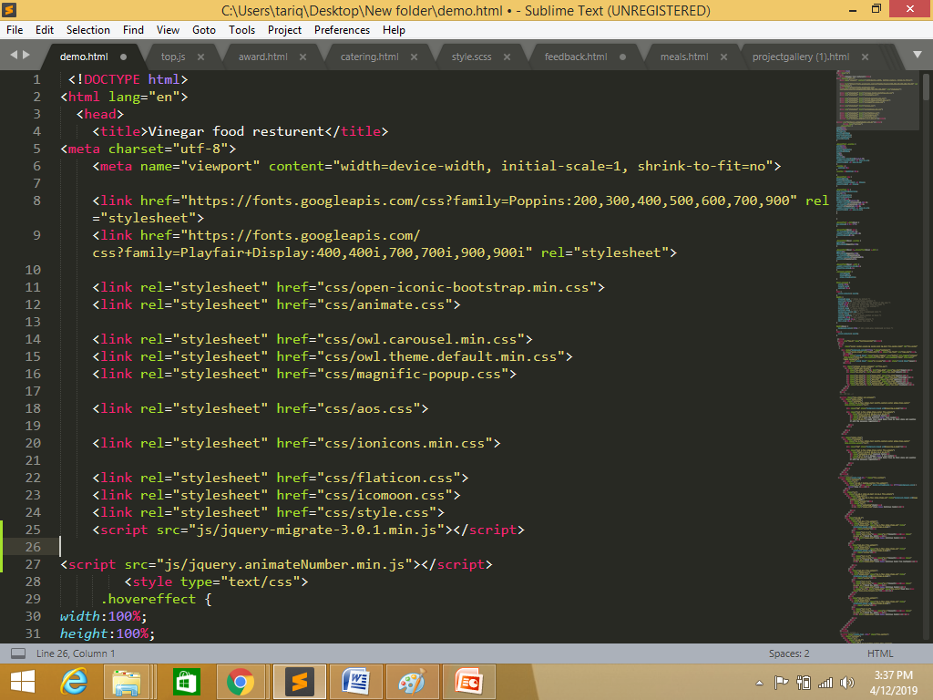
Requirment
You can add additional links as well as modify but make sure all the type of
food must be included.

Slide 17
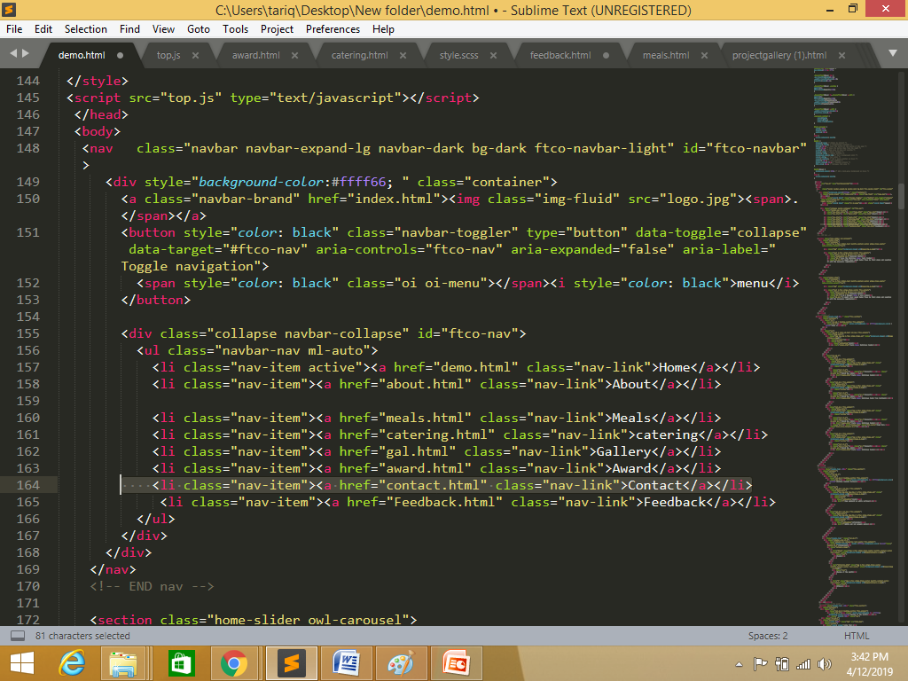
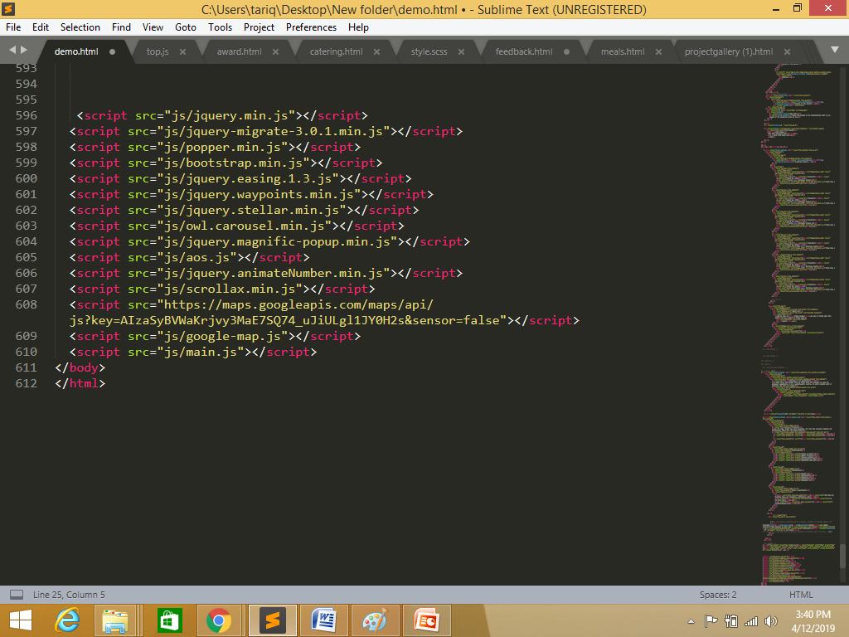
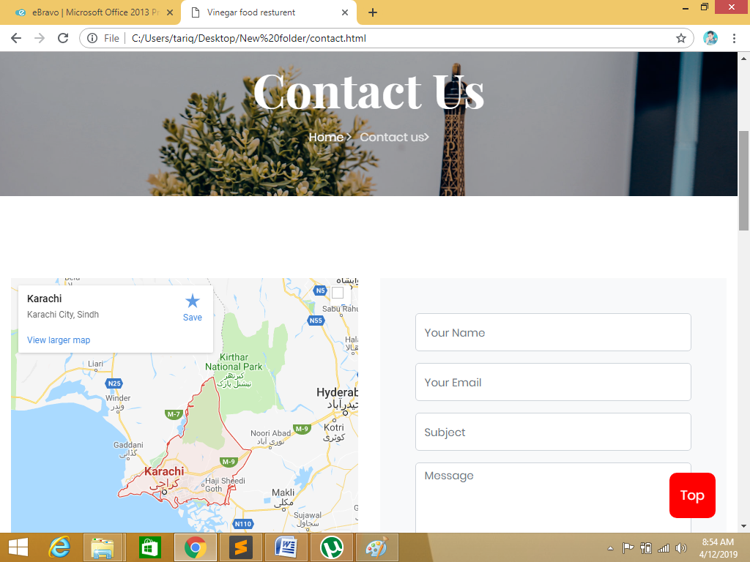
Requirments
Requirment9)
Site map, Gallery, about us, Queries link, Contact us link must be added.

Slide 18
THANK YOU

